Slide 1
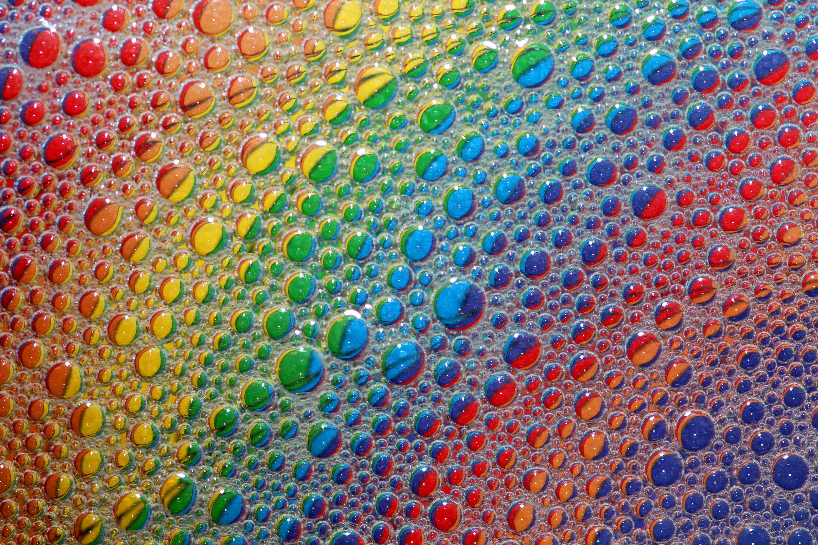
Spotify Songs Clustering Project with Unsupervised Learning
Sneha Sondur
December 2025
Link to GitHub Repository:
https://github.com/SnehaSondur/DTSA-5510_Unsupervised_ML_FINAL_Project/blob/main/Final_Project_ML.ipynb

Slide 2
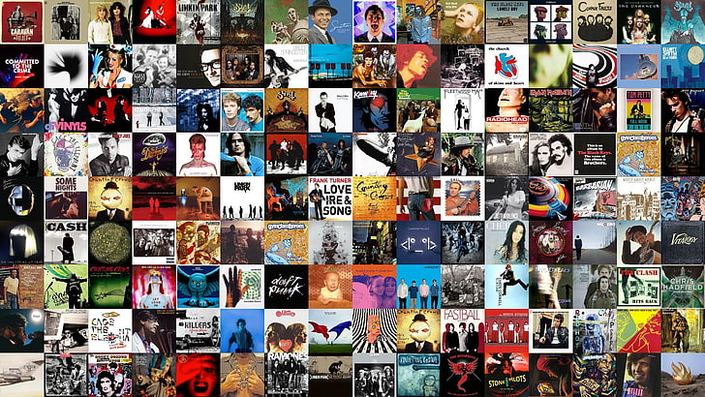
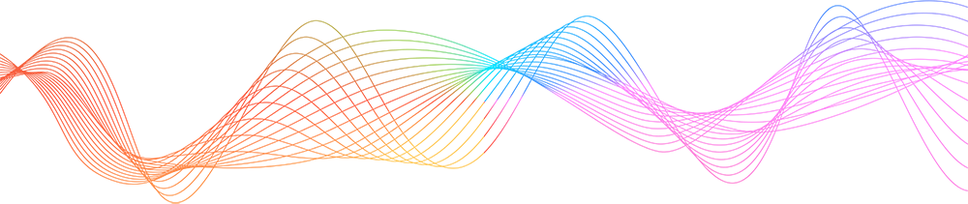
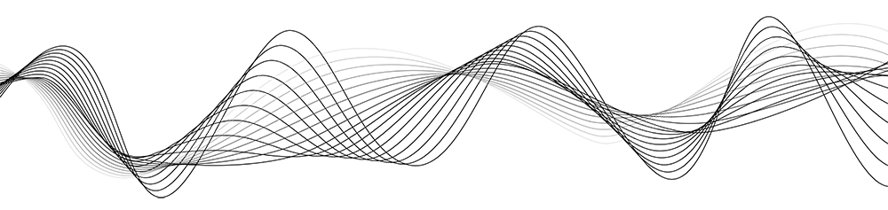
Introduction & Problem
Goal: Discover latent “music style clusters” using audio features
Applications: playlist generation, recommendation, exploratory analysis
Dataset: 170K Spotify tracks (1921–2020)
Data source: https://www.kaggle.com/datasets/yamaerenay/spotify-dataset-1921-2020-160k-tracks
Data: Spotify tracks over a range of different genres and 160K tracks. Each track has some audio features associated with it.

Slide 3
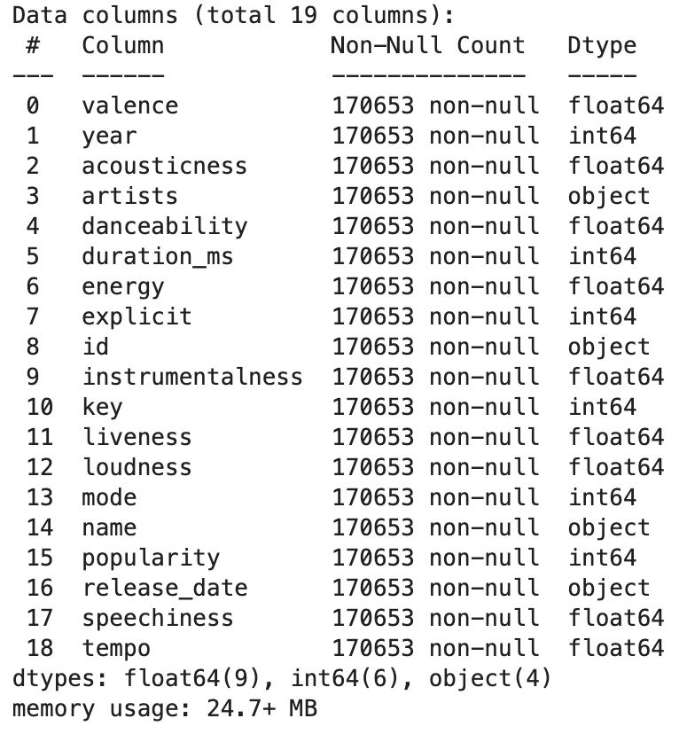
Data Overview
Libraries used for project:
pandas, numpy, matplotlib, seaborn, scipy.stats, sklearn.preprocessing, sklearn.decomposition, sklearn.cluster, and sklearn. metrics.
Data: 170K tracks, 19 columns(features)
Key features:
danceability, energy, valence, acousticness, loudness, tempo, instrumentalness, liveness
No missing values in audio features

Slide 4
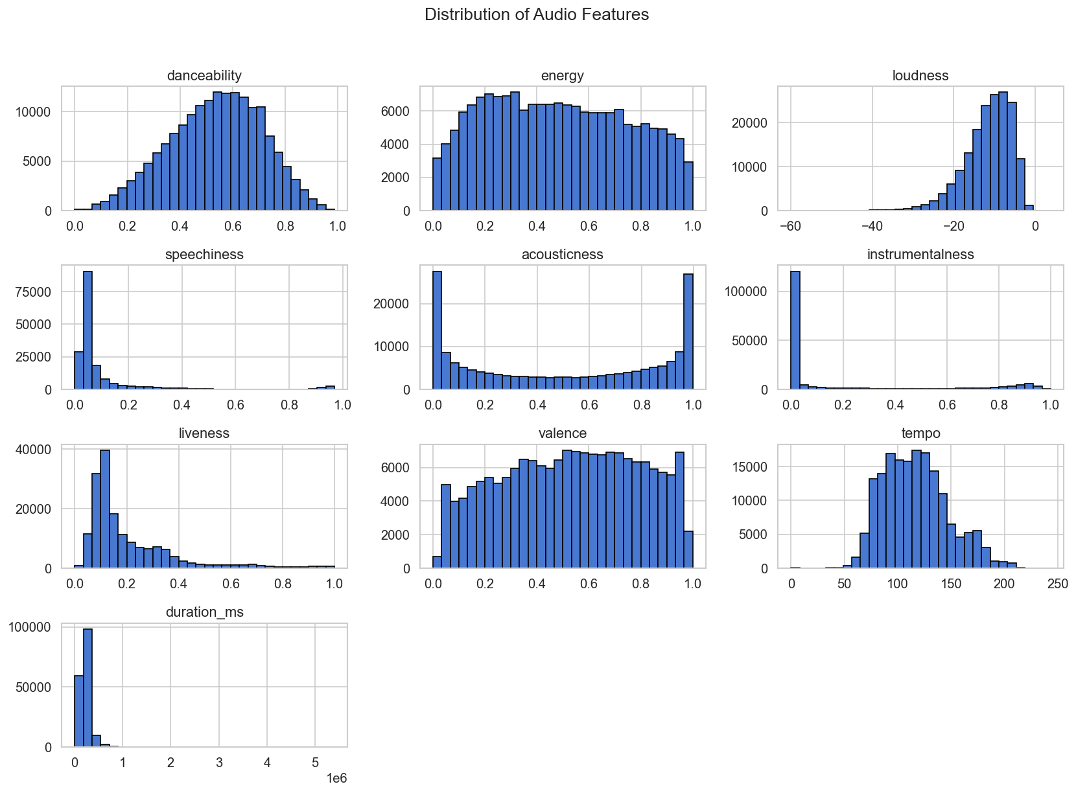
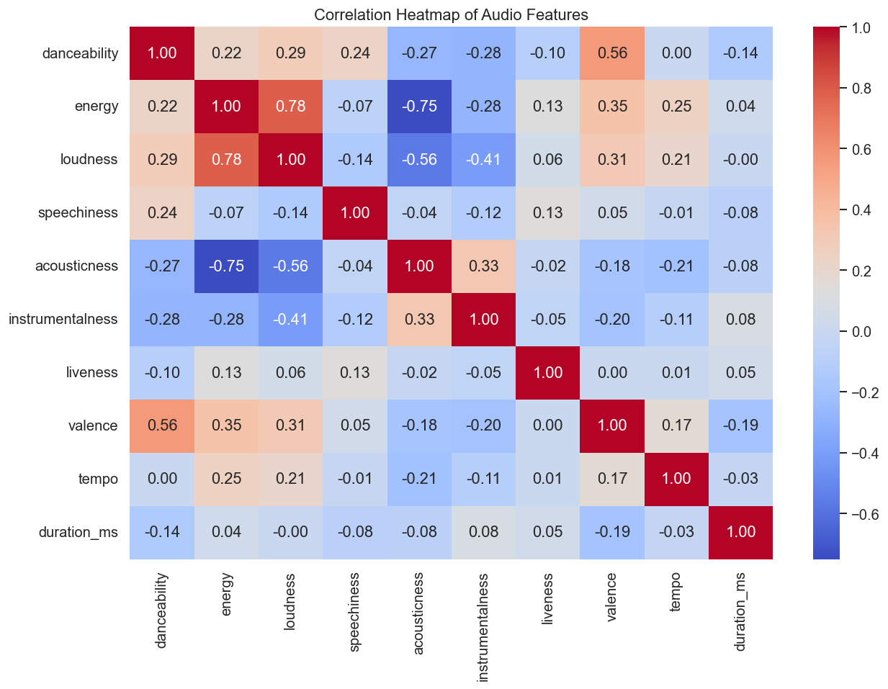
EDA- Exploratory Data Analysis
Skewed features: duration_ms, speechiness
Outliers: duration, loudness, tempo
Correlations:
energy ↔ loudness (+),
acousticness ↔ energy (–),
valence ↔ danceability (+)

Slide 5
Preprocessing
No missing values
Dropped skewed features (duration_ms, speechiness)
Removed extreme outliers (Z < 8)
Standardized features for fair clustering
Raw Data
Missing Values
Cleaning
Dropping unwanted features
Scaling

Slide 6
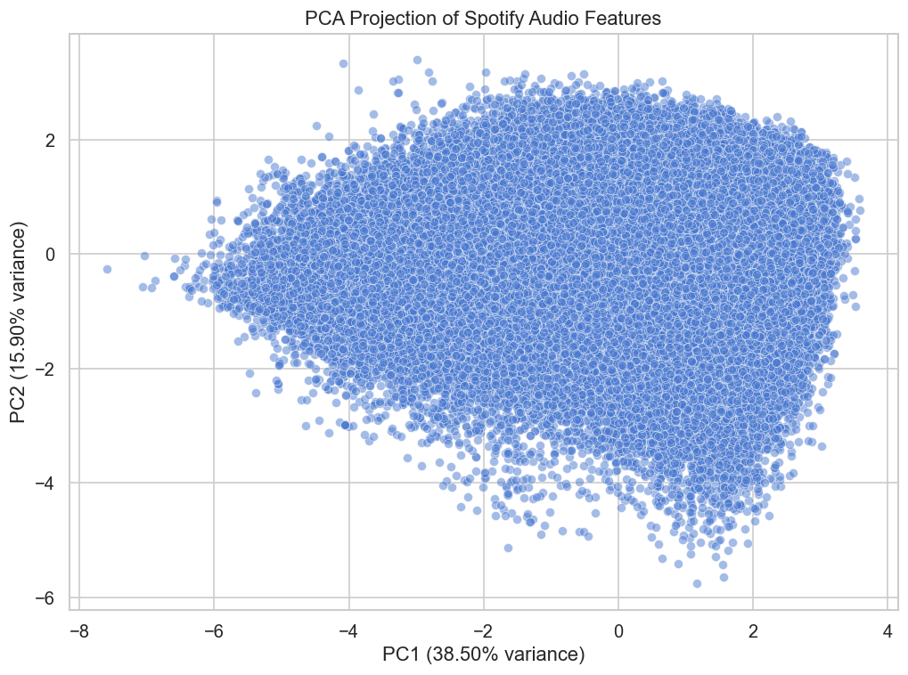
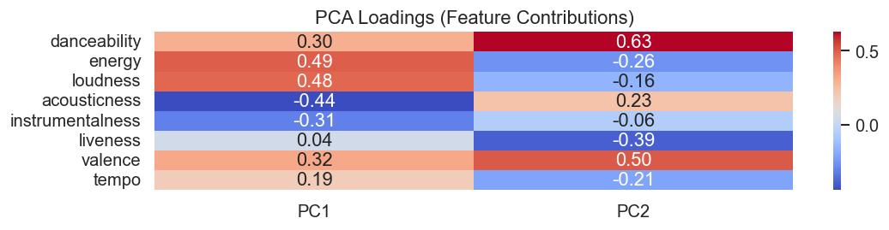
PCA Analysis
PCA reduces dimensionality and helps visualize structure in 2D
PC1 (~39% variance): energy, loudness, acousticness
PC2 (~16% variance): danceability, valence, liveness
PCA scatter plot shows structure in 2D

Slide 7
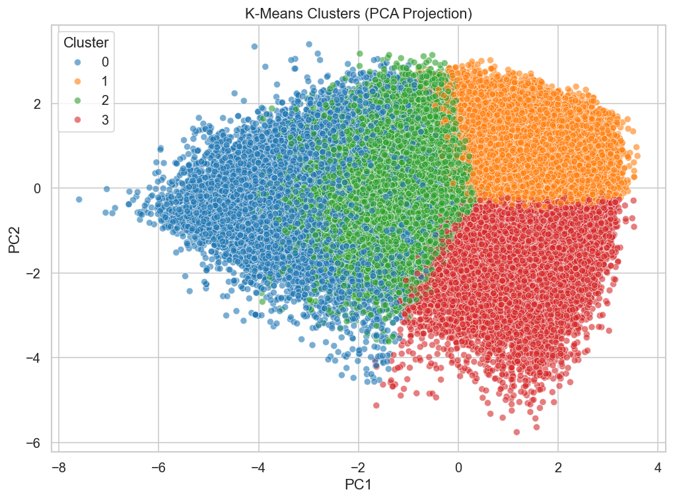
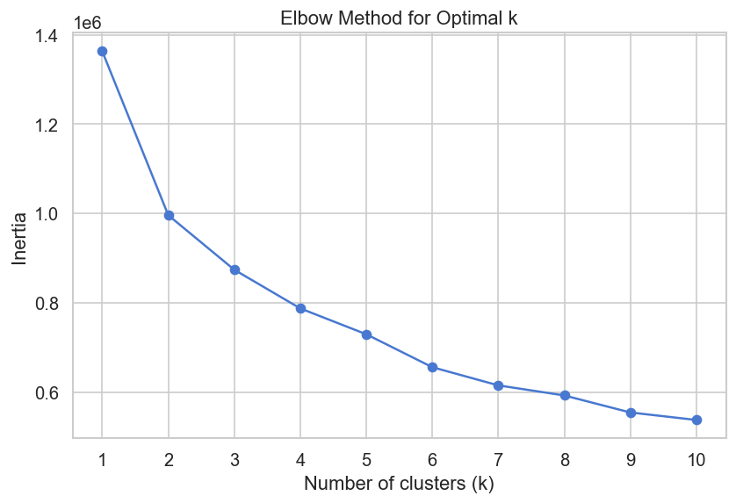
K‑Means Clustering
Elbow method suggests k=4
Silhouette scores modest (~0.20) → overlapping styles expected
PCA projection shows 4 clusters with partial separation

Slide 8
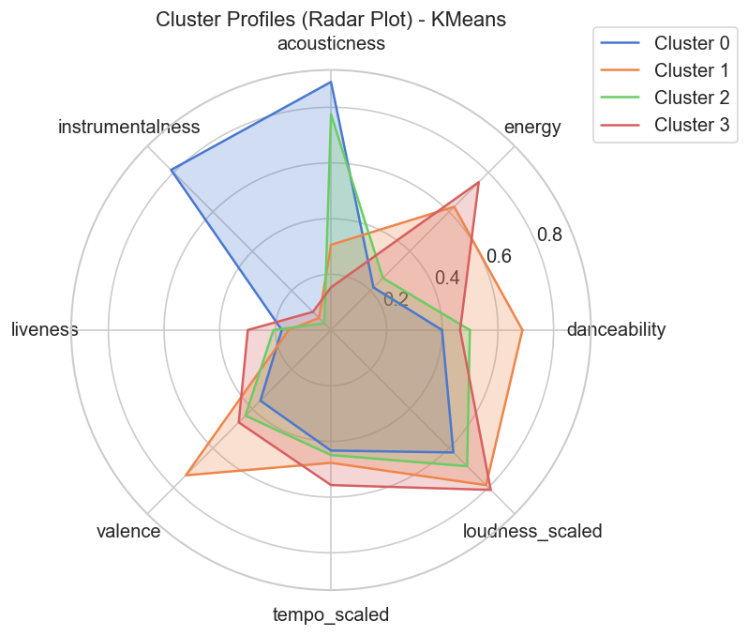
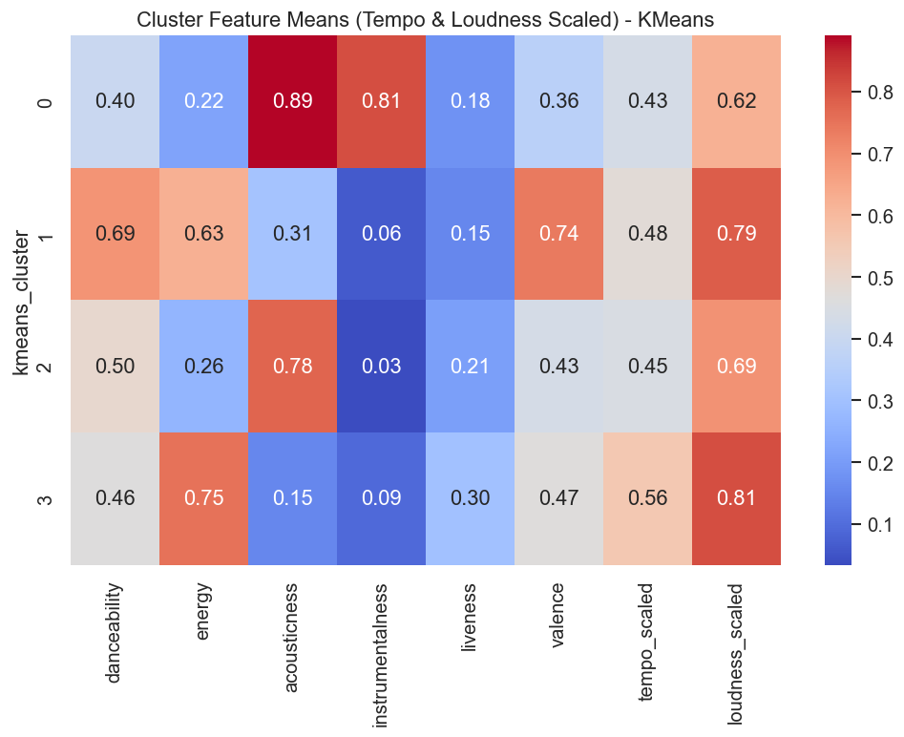
Cluster Profiles (K‑Means)
Cluster 0: Acoustic/Instrumental, mellow, soft tracks
Cluster 1: Pop/Dance, upbeat, happy vibe
Cluster 2: Acoustic Singer‑Songwriter, emotional, reflective
Cluster 3: Rock/Live, loud, fast, energetic

Slide 9
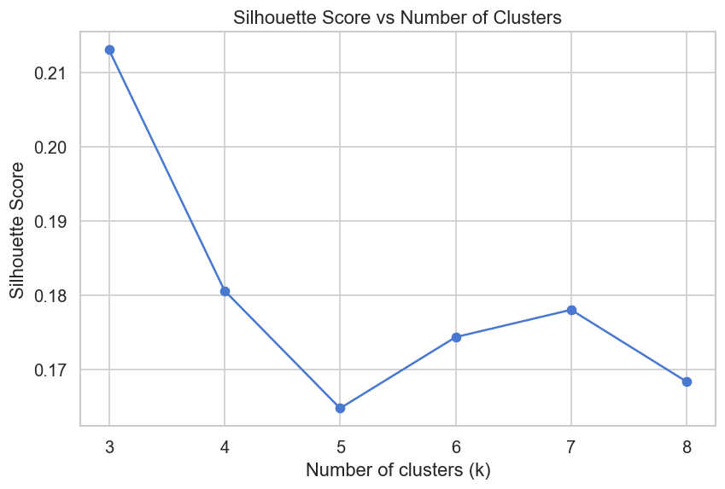
Hyperparameter Tuning
Compared k=3–8 using silhouette scores
Best scores at k=3, but k=4 interpretable clusters retained
Trade‑off: quantitative vs interpretability

Slide 10
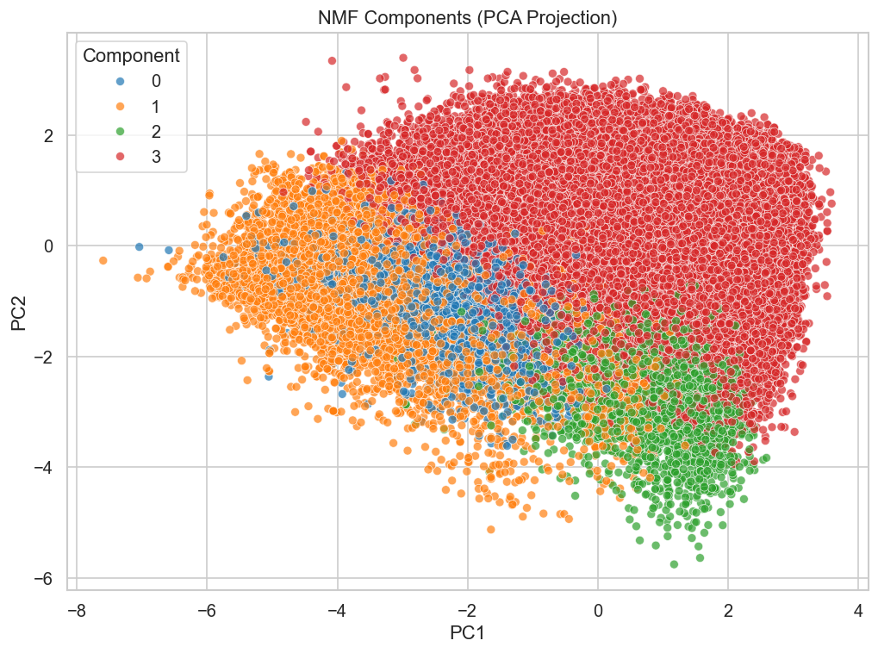
Non-Negative Matrix Factorization (NMF)
NMF (Non-Negative Matrix Factorization) which is a dimensionality reduction technique that decomposes the dataset into latent components
Songs often blend across styles

Slide 11
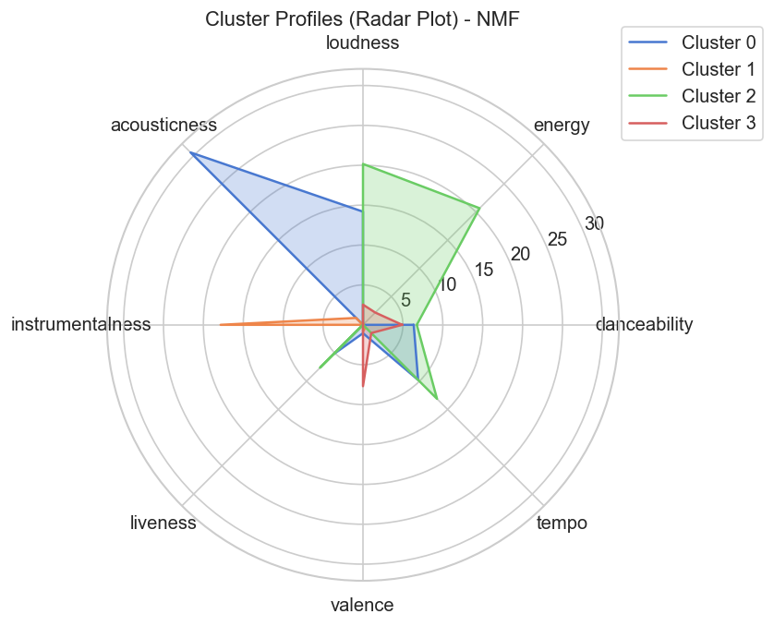
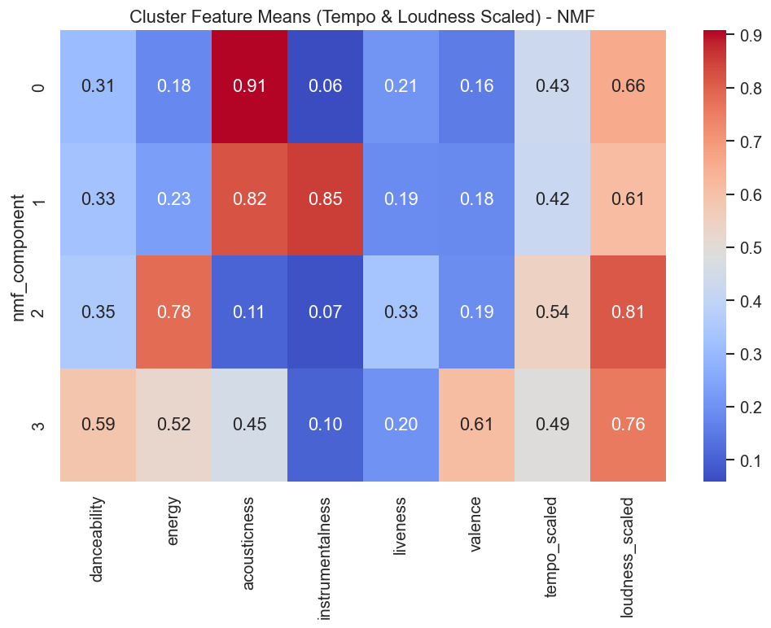
Cluster Profiles (NMF)
Component 0: Acoustic/Folk
Component 1: Instrumental/Classical
Component 2: High‑energy Pop/Rock
Component 3: Upbeat Pop

Slide 12
Model Comparison and Conclusion
K‑Means: clear, interpretable clusters, modest separation
NMF: latent styles, captures blends
K‑Means gave clear, interpretable clusters, while NMF uncovered blended styles.
This dual perspective is valuable for applications like playlist generation, where you want both distinct categories and blended recommendations
Unsupervised learning organizes musical space into meaningful archetypes
Applications: playlist generation, recommendation systems

Slide 13
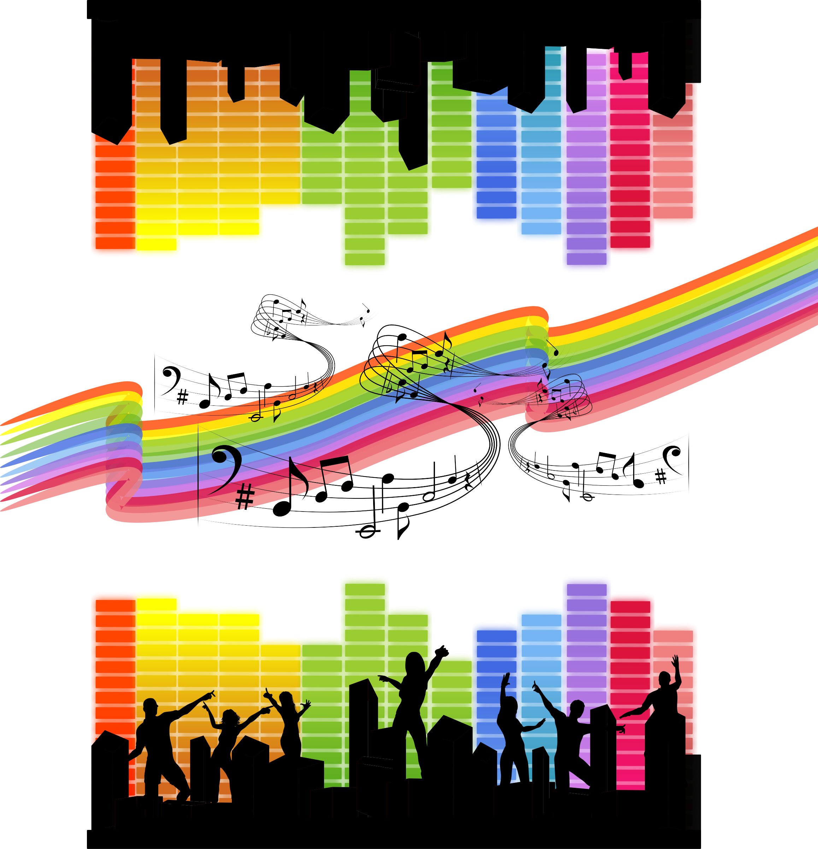
Thank you!
Link to GitHub Repository:
https://github.com/SnehaSondur/DTSA-5510_Unsupervised_ML_FINAL_Project/blob/main/Final_Project_ML.ipynb

